Slide 1


Exploratory Data Analysis of Unicorn Companies
Python for analytics project 2023 – July daf
By: john ohigbai OHIOSIKHA

Slide 2
Contents
Unicorn companies that had the biggest return on investment.
How long it took companies to become a unicorn.
Countries and cities with most unicorns.
Investors that funded the most unicorns.

Slide 3
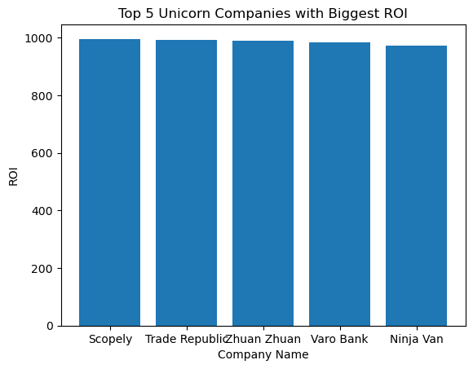
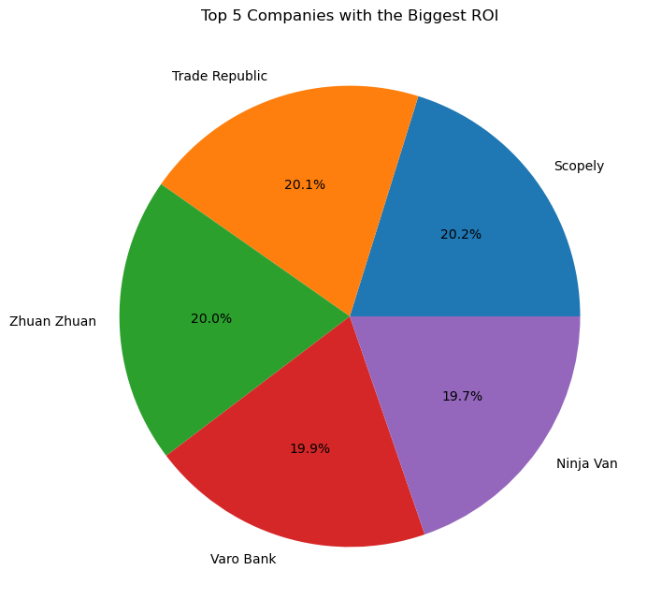
Unicorn Companies that had the biggest Return on Investment (ROI)
Key Observations
* The companies with the biggest ROI are Scopely, Trade Republic, Zhuan Zhuan, Varo Bank, and Ninja Van.
* These companies have demonstrated significant growth and generated substantial returns for their investors.
* The industries represented among the top 5 companies include mobile & telecommunications, fintech, e-commerce & direct-to-consumer, and supply chain logistics.
* The companies are headquartered in various cities and countries, including Culver City (United States), Berlin (Germany), Beijing (China), San Francisco (United States), and Singapore.
* The ROI values for these companies range from 973% to 996%, indicating the substantial returns achieved by their investors.
* Concentration of ROI: The pie chart shows the distribution of ROI among the top 5 companies. It is evident that a few companies have achieved significant ROI compared to others, as indicated by their larger slices in the chart.
* Leading Companies: The companies represented by the larger slices in the pie chart are the top performers in terms of ROI. These companies have generated substantial returns on their investments, which makes them notable players in the market.
* ROI Disparities: There may be noticeable disparities in ROI between the top 5 companies. Some companies might have achieved exceptionally high ROI, while others might have relatively lower ROI within this group.
* Investment Success: The pie chart highlights successful investments, as companies with high ROI indicate profitable ventures. It suggests that these companies have effectively utilized their resources and generated significant returns for their investors.

Slide 4
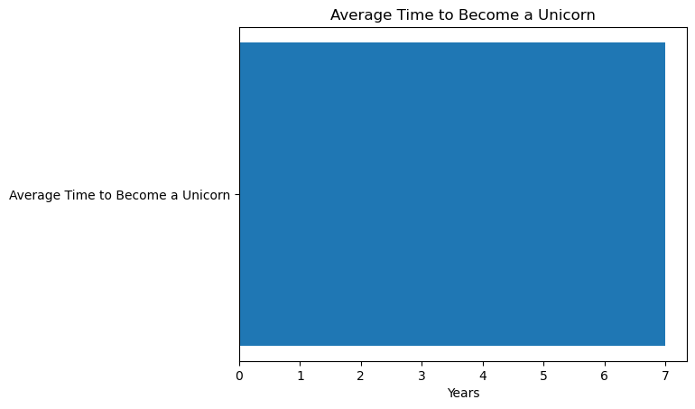
Time it took Companies to become Unicorn
Key Observations:
* The average time to become a unicorn is approximately 6.5 years.
* This suggests that it takes several years for a startup to grow and scale its business to reach a valuation of $1 billion.
* Factors such as the industry, market conditions, funding, and management team can all play a role in how long it takes for a company to become a unicorn.
5.Knowing the average time it takes to become a unicorn can be useful for entrepreneurs and investors in setting realistic expectations and planning for the long-term growth of their businesses.

Slide 5
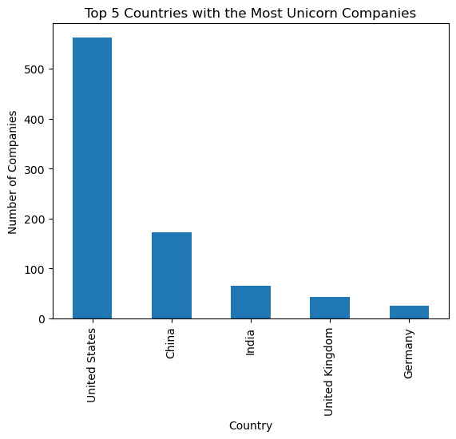
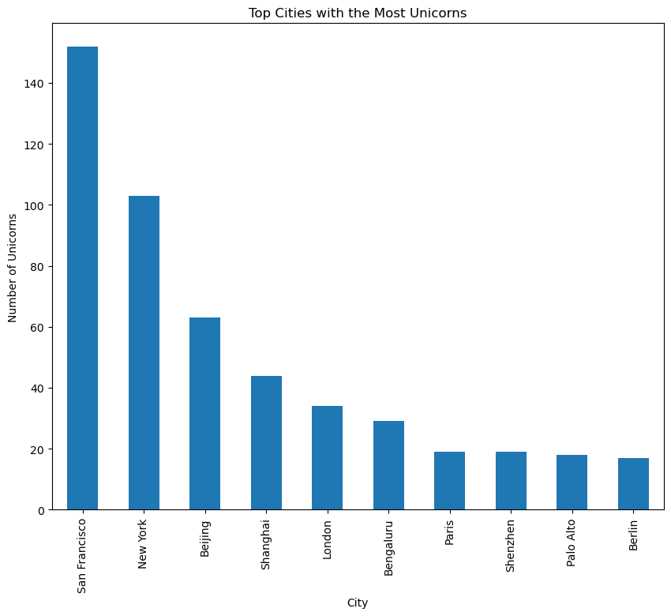
Countries and Cities with most Unicorns
Key observations:
* The United States has the highest number of unicorn companies, followed by China, India, the United Kingdom, and Germany.
* The number of unicorn companies in the top 5 countries varies, with the United States having a significantly larger number compared to the other countries.
* The top 5 countries are spread across different continents, indicating a global distribution of unicorn companies.
* San Francisco has the highest number of unicorn companies, with over 50.
* Other cities in the top 10 include New York, Beijing, Shanghai, London, Bengaluru, Hangzhou, Boston, Stockholm, and Tel Aviv.
* The number of unicorn companies in the top 10 cities varies widely, with San Francisco having more than twice as many unicorn companies as the next highest city.
* The top 10 cities are located in North America, Europe, and Asia, indicating that unicorn companies are distributed globally.

Slide 6
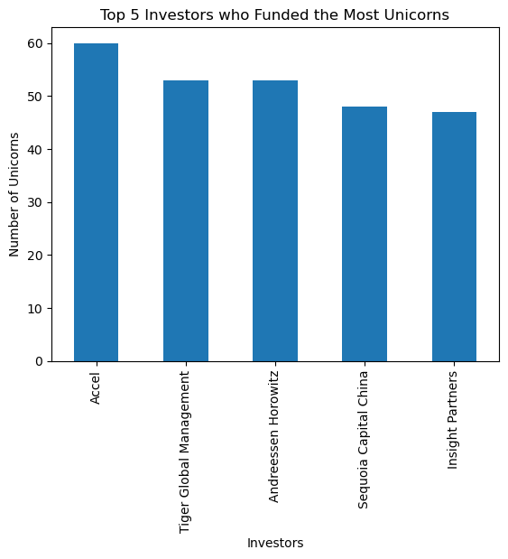
Investors that funded the most Unicorns
Key observations:
* Accel is the top investor who has funded the most unicorns, followed by Tiger Global Management, Andreessen Horowitz, Sequoia Capital China and insight Partners.
* The top 5 investors who have funded the most unicorns and the number of unicorns they have funded:
Accel: 60 unicorns
Tiger Global Management: 53 unicorns
Andreessen Horowitz: 53 unicorns
Sequoia Capital China: 48 unicorns
Insight Partners: 47 unicorns
* The top investors who have funded the most unicorns are all venture capital firms, indicating that venture capital plays a significant role in funding unicorn companies.
* These investors have a significant presence in the unicorn ecosystem and have been instrumental in funding some of the most successful startups globally. Their investments have enabled these startups to grow and scale, contributing to job creation, innovation, and economic growth.

Slide 7
Overall Recommendation
Four (4) data-driven overall recommendations to help unicorn companies create good business models and make decisions that focus on high-growth potential, diverse investment portfolios, and experienced leadership:
* Prioritize companies with experienced leadership: The data shows that companies with experienced leadership are more likely to succeed and generate higher returns for investors. Therefore, unicorn companies should prioritize investing in or partnering with companies that have a leadership team with a proven track record of success in their industry.
* Diversify investment portfolio: The data shows that unicorn companies come from a variety of industries, including mobile & telecommunications, fintech, e-commerce & direct-to-consumer, and supply chain logistics. Therefore, unicorn companies should consider diversifying their investment portfolio by investing in companies from different industries to reduce risk and maximize returns.
* Focus on companies with high-growth potential: The data shows that the majority of unicorn companies in the dataset joined the unicorn club between 2017 and 2021, indicating significant growth potential in recent years. Unicorn companies should focus on identifying and investing in companies with high-growth potential to maximize returns.
* Leverage technology and data analytics: The data shows that technology and data analytics have played a significant role in the growth and success of unicorn companies. Therefore, unicorn companies should leverage technology and data analytics to improve their business models, identify growth opportunities, and make data-driven decisions.
By following these four recommendations, unicorn companies can create good business models, make informed investment decisions, and maximize returns for their investors.

